Slide 1

HATE SPEECH DETECTION
TEAM MEMBERS
2010030442 : Karthikeya
2010030420 : Ganesh
2010030350 : Rishik sai
2010030569 : Kishore

Slide 2

INTRODUCTION
Basically the hate texts that are considered toxic are those that are impolite, show disrespect, or have a tendency to drive away from the conversation.
These texts contain dangers such as high-toxicity texts that lead to personal insults, online abuse, and bullying habits that are harmful to a person's psychological health and emotional well-being.
An automated system must be formulated to keep away, remove, or identify such harmful content.
The main goal of this project is to propose a NLP model to detect toxic or non-toxic texts with higher accuracy.

Slide 3

Objective
The purpose of this project is to produce a hate expression detection model that can be applied in chatting situations, and there are restrictions on the task. Because it needs to be able to react in real time, (1) it should have fast inference speed, (2) it should be able to classify it well, and (3) it should be able to perform well in general, not specific situations. In addition, (4) attempts were made to detect including the context.
We came up with Natural language processing(NLP) that provides a helping hand in the identification of toxicity in texts expressed as images or texts.

Slide 4
Literature Servey
S.NO | Name | Author | Objective | Algorithm | Dataset | Conclusion
1 | Keeping Children safe online with limited resources: Analyzing what is seen and what is heard. | ALEKSANDAR JEVREMOVIC, MLADEN VEINOVIC , MILAN CABARKAPA | Designed a framework(Casper) which will directly analyzes at the content what the user sees and hears. | BERT, for images CNN, LSTM, BLSTM. | Twitter sexism parsed You tube parsed Toxicity parsed Attack parsed | Accuracy- 95% Audio Accuracy-91%

Slide 5
2. | Multilingual Sentiment Analysis and Toxicity Detection for Text Messages in Russian | Darya Bogoradnikova, Olesia Makhnytkina, Anton Matveev, Anastasia Zakharova, Artem Akulov | In this paper, they discuss an approach to sentiment analysis and emotion identification for user comments. | 1.Text pre-processing 2.Data Augmentation 3.Sentiment analysis 4. Detection of toxic comments 5. Detection of toxic spans. | The dataset contains 1703 user reviews in Russian from two online education platforms: Coursera and Stepik | Finally, they achieved a complex solution for evaluating users’ opinions about online-courses.

Slide 6
3. | Detecting Islamic Radicalism Arabic Tweets Using Natural Language Processing | KHALID T. MURSI ,MOHAMMAD D. ALAHMADI, FAISAL S. ALSUBAEI ,AND AHMED S. ALGHAMDI | To automate the process of detecting hateful tweets, utilized advanced Machine Learning (ML) techniques and perform sentiment analysis to capture the meaning of the Arabic words in a proper word embedding (Word2Vec) | Word2vec | 100,000 tweets of the last decade. | Determined the most frequent terminologies in the radical tweets of each year which include some Jihadist groups, Countries, and Individuals. This work can help law enforcement to analyze and detect extremism in social media.

Slide 7

Model
BERT (Bidirectional Encoder Representations from Transformers) is a Natural Language Processing Model proposed by researchers at Google Research in 2018.
Semi-supervised Learning: One of the main reasons for the good performance of BERT on different NLP tasks was the use of Semi-Supervised Learning. This means the model is trained for a specific task that enables it to understand the patterns of the language. After training the model (BERT) has language processing capabilities that can be used to empower other models that we build and train using supervised learning.

Slide 8
Work Allocation
Serial No. | Team Member | Role to be assigned
1. | Rishik Sai | coding and Research
2. | Ganesh | Coding and data collection
3. | Karthikeya | Research and Documentation
4. | Kishore | Coding and Documantation

Slide 9
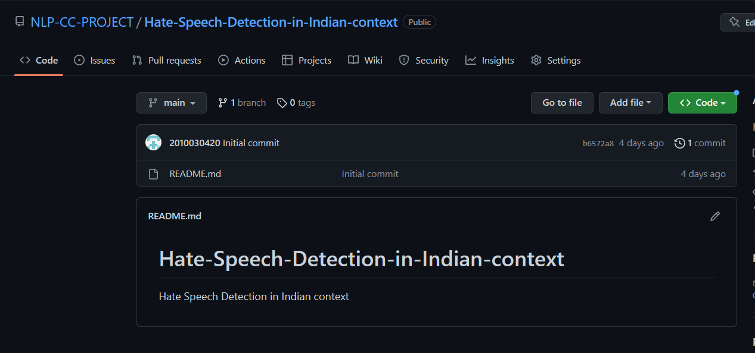
Github

Slide 10
Thank you

